Slide 1


Updates
Olivier Bergeron

Slide 2

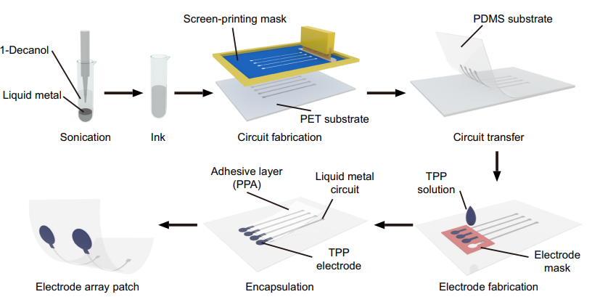
Electrode fabrication process
Answer from Ankur: Feasible

Slide 3
Interesting articles (#1)
M. Chen et P. Zhou, « 2CFastICA: A Novel Method for High Density Surface EMG Decomposition Based on Kernel Constrained FastICA and Correlation Constrained FastICA », IEEE Trans. Neural Syst. Rehabil. Eng., vol. 32, p. 2177‑2186, 2024

Slide 4
Interesting articles (#1)
2CFastICA: Upgrade from FastICA
Open-source code available
Problems withs FastICA:
Cannot differentiate a new motor unit from a time delayed equivalent of the first motor unit –> local convergence

Slide 5
Interesting articles (#1)
First solution proposed: Progressive FastICA Peel-Off (PFP)
To avoid rediscovering again the same motor unit, its contribution to the EMG signal is subtracted from the original signal. FastICA is then applied to the residual to find other motor units
Problem with PFP:
Needs accurate MUAP estimation
Accumulation of errors
Computationally expensive

Slide 6
Interesting articles (#1)
New solution: 2CFastICA
Instead of removing motor unit from the signal, it’s removed from the FastICA’s search space.
Done mathematically through constraints instead of substraction

Slide 7
Interesting articles (#1)
Experiments done:
Simulation study
Robust to noise
Comparable to PFP
Two-source validation (intramuscular EMG)
Matching rate of 97%
Two-source validation (ALS surface EMG)
Matching rate of 99%

Slide 8
Interesting articles (#1)
Advantages for 2CFastICA vs PFP:
Faster
More scalable
Better suited for real-time applications

Slide 9
Interesting articles (#2)
A. Ch. Lazanas et M. I. Prodromidis, « Electrochemical Impedance Spectroscopy─A Tutorial », ACS Meas. Sci. Au, vol. 3, nº 3, p. 162‑193, juin 2023[1]
Method for measuring electrode impedance: Electrochemical impedance spectroscopy (EIS)
Reading in progess

Slide 10
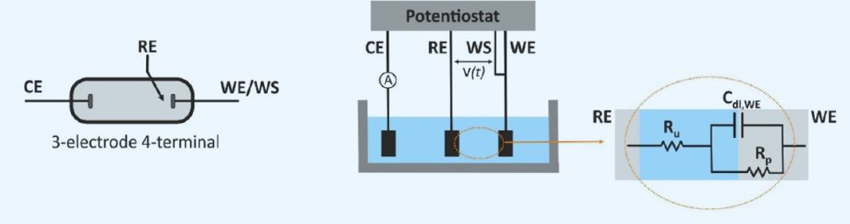
Interesting articles (#2)

